Slide 1
Tech champion
-L2 network topology

Slide 2
Background
OpenStack, OpenVSwitch
L3 network topology available
L2 network topology?
vaxthus idea
    https://ericoll.internal.ericsson.com/sites/IdeaBoxes/Ideas/display.aspx?ID=Pgz+zn/eTtI=&title=M4sc8MGguNgQmlKkvVGVA4EpbnTbICYIudxzL+DSnzyE7eWrdjD73BUDAPCXUgOALHN/MnZJMJNxAapyCT5C/qnzO1ahLp2i&src=http%3a%2f%2fericoll.internal.ericsson.com%3a80%2fsites%2fIdeaBoxes%2fMyIdeas.aspx

Slide 3
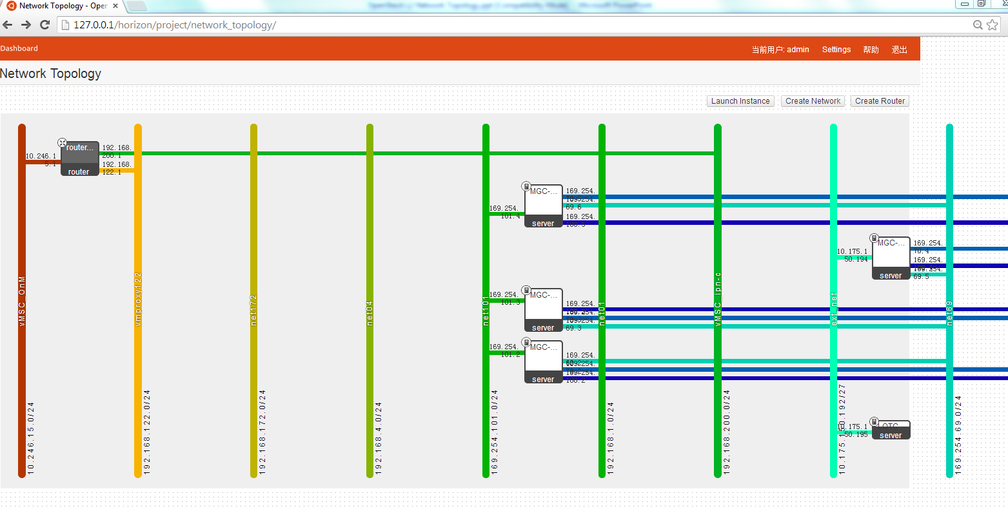
L3 network topology example

Slide 4
Openstack Demo setup
SSH to below ITTE RSG
  IP:10.175.245.2
  Username:rdcchhb, password:Rdcchhb_123
SSH to OpenStack Server
  IP:10.175.150.3
  Username:localadmin, password:3r1cs50n (talk with James to set a new account).
Setup SSH tunnel on port 80 and 6080 via ITTE RSG. Access Horizon (OpenStack Dashboard) as below:
  http://127.0.0.1/horizon (use chrome or firefox)
  Username:admin, password:admin
  Please do not change the password and configurations of the demo setup.

Slide 5
How to Retrieve L2 network info
Commands or APIs
  OpenVSwitch Info
    ovs-vsctl show
  Linux Bridge Info (optional)
    brctl show
  NIC Device Info
    ifconfig
  OpenStack Network/Subnet/Port Info
    quantum net-list; quantum subnet-list; quantum port-list;
  OpenStack VM Info
    nova list

Slide 6
objectives
Get a L2 network topology including below information:
  L2 devices, including physical nics, bridges, tap/vnet devices, VMs.
  L2 network connection between all above-mentioned devices.
  See next slide for an example.

Slide 7
L2 setup example
Openstack(grizzly) setup @ demo lab
Interface Legend
Host: 10.175.150.5
Host: 10.175.150.3
Untagged
VM1
VM2
VM3
VM4
Tagged
eth0
eth0
eth1
eth0
eth0
tapxxxx
tapyyyy
tapzzzz
tapuuuu
tapvvvv
ETHA/B
ETHA/B
qbrxxxx
qbryyyy
qbrzzzz
qbruuuu
qbrvvvv
Device Legend
qvbxxxx
qvbyyyy
qvbzzzz
qvbuuuu
qvbvvvv
TAP Device
ETH Device
qvoxxxx
tap-cp-a
qvoyyyy
qvozzzz
qvouuuu
tap-cp-a
qvovvvv
VETH Pair
br-int
br-int
Linux Bridge
Int-br-ex
Int-br-eth2
Int-br-eth2
Int-br-ex
OVS Bridge
phy-br-ex
phy-br-eth2
phy-br-eth2
phy-br-ex
br-ex
br-eth2
br-eth2
br-ex
eth3
eth2
eth2
eth3
external
internal
external
L2 Network

Slide 8
O2Top system
Main idea:
  Fetch command output via SSH
  Parse the content, and build the image
  Visualization
Tech shooting
  Java: JCAT SSH/IO/Graphic
Visualizer
Parser
Main
Controller
Openstack
Server
SSH
Parse request
Raw data
Parse result
Visualization

Slide 9

Stories
1) Openstack command investigation
  ovs-vsctl, brctl, ifconfig, quantum netlist/subnet-list/port-list, nova list
2) Java graphic library selection
3) Openstack graphic element definition
4) Java environment setup – eclipse/git/graphic
5) SSH raw data obtain - L2 topology string data
6) Command output parse – class description
7) Element drawing for each component
8) Drawing integration
9) Demo

Slide 10
Advanced feature
Integrate with OpenStack Horizon
Change adaption - polling?
Whole OpenStack setup
Network connection status

Slide 11
Schedule
1
2
3
4
Mon
Tue
Wed
Thu
Fri
5
6
7
8
9

Slide 12
Team profile
Open stack experts
  Ming, Jay, Wenliang, Shuai, Lynn
Java experts
  Shuai, Yingjie, Cherry, Lynn
External support
  All RPers!

